Slide 1


Angela Giraldi
13 July 2023

Slide 2
Outline
Executive Summary
Introduction
Methodology
Results
Conclusion
Appendix

Slide 3
1) Executive Summary
The Commercial Space Age is Here!
Introducing SPACE Y: Making Space travel affordable for Everyone
Methodologies:
Data Collection: API & Web Scraping
Data Wrangling
Exploratory Data Analysis: SQL, Pandas, Matplotlib
Interactive Visual Analytics & Dashboard: Folium, Plotly Dash
Predictive Analysis (Classification)
Hyperparameter Optimization: Logistic Regression, SVM, Decision Tree, KNN
Best Performing Method using Test Data

Slide 4
1) Executive Summary
Results:
Data-driven insights
Optimal hyperparameters for accuracy
Meaningful patterns & correlations discovered
Interactive visualizations for exploration
Predictive analysis for proactive decision-making
Join SPACE Y in revolutionizing the commercial space industry!

Slide 5
2) Introduction
Project Background:
Competing in the Commercial Space Race
Making Rocket Launches Affordable for Everyone
Context:
Rising Interest in Space Exploration and Tourism
Increasing Demand for Cost-Effective Rocket Launches
Problems to Solve:
High Launch Costs:
Current rocket launches are prohibitively expensive.
Need to find innovative solutions to reduce costs.
Reusability Challenges:
First stages of rockets are typically discarded after launch.
Exploring ways to reuse the first stage for significant cost savings.
Competitor Analysis:
Assessing competitor first-stage landings.
Determining the impact on launch costs using Data Science and ML models.

Slide 6

Section 1

Slide 7
3) Methodology
Executive Summary
a) Data collection methodology
Data for the project was collected from the SpaceX REST API and through web scraping from wiki pages.
b) Perform data wrangling
The collected data is in the form of a JSON object and HTML tables, which is then transformed into a Pandas dataframe for visualization and analysis purposes.
c) Perform exploratory data analysis (EDA) using visualization and SQL
d) Perform interactive visual analytics using Folium and Plotly Dash
e) Perform predictive analysis using classification models
Machine learning techniques are employed to predict the successful landing of Falcon 9 first stage.

Slide 8
3.a) Data Collection
The data was obtained by leveraging the SpaceX REST API and performing web scraping on wiki pages.
SpaceX REST API endpoint
Get request using the requests library
Get past launch data as a JSON objects
Convert the JSON to a dataframe
Web scraping Falcon 9 launch records
Use BeautifulSoup to web scrape HTMLtables
Parse data from tables
Convert tables into a dataframe

Slide 9
3.a) Data Collection – SpaceX API
SpaceX REST API endpoint
Get request using the requests library
Extract information about booster name, launch site, payload mass and landing site
Get the past launch data as a JSON object
Convert the JSON to a dataframe
Deal with Missing Values
Data Wrangling
Filter the dataframe to only include Falcon 9 launches
Data collection API notebook

Slide 10
3.a) Data Collection – Scraping
Request the Falcon9 Launch Wiki page from its URL
BeautifulSoup object from the response
Extract all column/variable names from the HTML table header
Create a data frame by parsing the launch HTML tables
Data Wrangling
Web scraping notebook

Slide 11
3.b) Data Wrangling
Through Exploratory Data Analysis (EDA), patterns within the data are examined to determine the appropriate label for training supervised models. The data is analyzed to identify relevant features and establish the target variable for predictive modeling.
Identify the missing values
Identify numerical or categorical columns
Calculate the number of launches on each site
Calculate the number and occurrence of each orbit
Calculate the number and occurence of mission outcome per orbit type
Create a landing outcome label from Outcome column
The classification outcome variable represents the success of the first stage landing: 0 indicates an unsuccessful landing, while 1 indicates a successful landing. This variable serves as the label for training supervised models.
Data wrangling notebook

Slide 12
3.c) EDA with Data Visualization
Summary of charts that were plotted:
CATPLOT to visualize the relationship between Flight Number and Payload.
CATPLOT to visualize the relationship between Flight Number and Launch Site.
CATPLOT to visualize the relationship between Payload and Launch Site.
BAR CHART to visualize the relationship between the success rate of each Orbit type.
CATPLOT to visualize the relationship between Flight Number and Orbit type.
CATPLOT to visualize the relationship between Payload and Orbit type.
LINE CHART to visualize the launch success yearly trend.
EDA with Data Visualization notebook

Slide 13
3.c) EDA with SQL
EDA with SQL notebook
SQL queries performed:
Display the names of the unique launch sites in the space mission:
SELECT DISTINCT LAUNCH_SITE FROM SPACEXTBL;
Display 5 records where launch sites begin with the string 'CCA":
SELECT LAUNCH_SITE FROM SPACEXTBL WHERE LAUNCH_SITE LIKE 'CCA%’ LIMIT 5;
Display the total payload mass carried by boosters launched by NASA (CRS):
SELECT SUM(PAYLOAD_MASS__KG_)FROM SPACEXTBL WHERE Customer = 'NASA (CRS)’;
Display average payload mass carried by booster version F9 v1.1:
SELECT AVG(PAYLOAD_MASS__KG_) FROM SPACEXTBL WHERE Booster_Version LIKE 'F9 v1.0%’;
List the date when the first successful landing outcome in ground pad was achieved:
SELECT MIN(DATE) FROM SPACEXTBL WHERE LANDING_OUTCOME = 'SUCCESS (GROUND PAD)’;

Slide 14
3.c) EDA with SQL
EDA with SQL notebook
SQL queries performed:
List the names of the boosters which have success in drone ship and have payload mass greater than 4000 but less than 6000:
SELECT BOOSTER_VERSION FROM SPACEXTBL WHERE LANDING_OUTCOME = 'SUCCESS (DRONE SHIP)' AND 4000 < PAYLOAD_MASS__KG_ < 6000;
List the total number of successful and failure mission outcomes:
SELECT MISSION_OUTCOME, COUNT(MISSION_OUTCOME) AS TOTAL_NUMBER FROM SPACEXTBL GROUP BY MISSION_OUTCOME;
List the names of the booster versions which have carried the maximum payload mass. Use a subquery:
SELECT DISTINCT BOOSTER_VERSION FROM SPACEXTBL WHERE PAYLOAD_MASS__KG_ = ( SELECT MAX(PAYLOAD_MASS__KG_) FROM SPACEXTBL);

Slide 15
3.c) EDA with SQL
EDA with SQL notebook
SQL queries performed:
List the failed landing_outcomes in drone ship, their booster versions, and launch site names for in year 2015:
SELECT SUBSTR(DATE,4,2) AS MONTH, LANDING_OUTCOME, BOOSTER_VERSION, LAUNCH_SITE FROM SPACEXTBL WHERE LANDING_OUTCOME = 'FAILURE (DRONE SHIP)’ AND SUBSTR(DATE,7,4) = 2015;
Rank the count of landing outcomes (such as Failure (drone ship) or Success (ground pad)) between the date 2010-06-04 and 2017-03-20, in descending order:
SELECT LANDING_OUTCOME, COUNT(LANDING_OUTCOME) AS TOTAL_NUMBER FROM SPACEXTBL WHERE DATE BETWEEN '2010-06-04' AND '2017-03-20’ GROUP BY LANDING_OUTCOME ORDER BY TOTAL_NUMBER DESC

Slide 16
3.d) Build an Interactive Map with Folium
Summary of map objects that were created and added to the Folium map:
folium.Circle and folium.Marker to add a highlighted circle area with a text label on a specific coordinate for each launch site on the site map.
MarkerCluster object for simplify a map containing many markers having the same coordinate.
MousePosition on the map to get coordinate for a mouse over a point on the map.
folium.PolyLine object to draw a line between a launch site to its closest city, railway and highway.
Folium notebook
Notes:
o

Slide 17
3.d) Build a Dashboard with Plotly Dash
Key Features of the Dashboard:
Range of Interactive Plots and Graphs:
Enables real-time visual analytics on space launch data
Facilitates exploration, analysis, and dynamic interaction
User Interactions:
Empowers users to gain valuable insights into space launches
Facilitates data exploration and analysis
Input Components:
Dropdown List and Range Slider
Enhances user interaction with the dashboard
Pie Chart Interaction:
Dropdown list selection influences pie chart visualization
Enables exploration of payload composition and distribution
Scatter Point Chart Interaction:
Range slider adjustment affects scatter point chart display
Facilitates analysis of launch-related parameters

Slide 18
3.d) Build a Dashboard with Plotly Dash
Launch Site Drop-down Input Component:
Allows selection from four different launch sites
Dropdown menu enables users to choose specific launch sites
Callback Function for Success-Pie-Chart:
Renders a pie chart based on the selected site from the dropdown
Visualizes launch success counts for the chosen launch site
Range Slider for Payload Selection:
Enables easy selection of different payload ranges
Facilitates identification of visual patterns in payload data
Callback Function for Success-Payload-Scatter-Chart:
Renders a scatter plot to observe the correlation between payload and mission outcomes
Focuses on the selected site(s) to analyze the relationship

Slide 19
3.d) Build a Dashboard with Plotly Dash
Benefits of the Dashboard:
Real-time insights into space launch data
Enhanced data exploration and analysis capabilities
Interactive elements empower users to make informed decisions
Benefits of Interactive Components and Callback Functions:
Enhanced user experience through interactive selection
Enables dynamic visualization of launch success and payload analysis
Facilitates identification of patterns and correlations
Interactive Dashbord with Plotly Dash

Slide 20
3.e) Predictive Analysis (Classification)
Summary of the Model Development Process:
Creation of NumPy Array:
Convert the "Class" column in the data to a NumPy array.
Prepare the target variable for prediction.
Data Standardization:
Standardize the input data to ensure uniformity and comparability.
Enhance the performance of the models.
Train-Test Split:
Utilize the "train_test_split" function to divide the data (X and Y) into training and test sets.
Establish a portion of the data for model training and evaluation.
Hyperparameter Optimization:
Conduct a search for the best hyperparameters for Logistic Regression, SVM, Decision Tree, and KNN classifiers.
Fine-tune the models to maximize their predictive performance.
Evaluation of Best Performing Method:
Evaluate different methods using the test data.
Identify the method that performs the best in terms of accuracy and reliability.

Slide 21
Load of the data
Convert the "Class" column in the data to a NumPy array, assign it to variable Y
Standardize the data in X
Split the data into training and testing data
Creation of a Logistic Regression, SVM, Decision Tree, KNN and GridSearchCV objects
Find the best parameters, calculate the accuracy and plot the confusion matrix
Selection of method that performs best
3.e) Predictive Analysis (Classification)
Machine Learning Prediction Notebook

Slide 22
4) Results
Exploratory data analysis results
Interactive analytics demo in screenshots
Predictive analysis results

Slide 23

Section 2

Slide 24

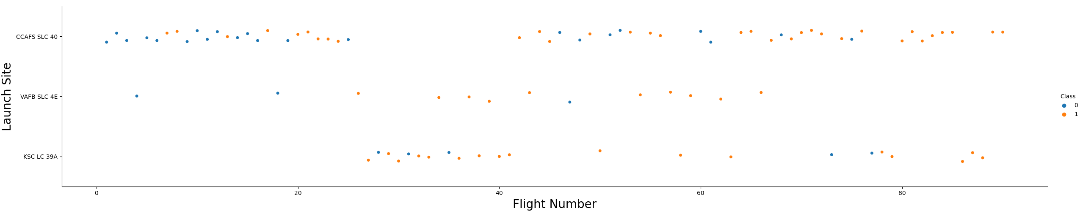
Flight Number vs. Launch Site
CCAFS SLC 40:
The majority of launches are concentrated at CCAFS SLC 40.
Over time, the successful launch rate has increased significantly at this site.
VAFB SLC 4E and KSC LC 39A:
VAFB SLC 4E and KSC LC 39A have a higher successful launch rate.
However, these sites represent only one third of the total number of launches.

Slide 25
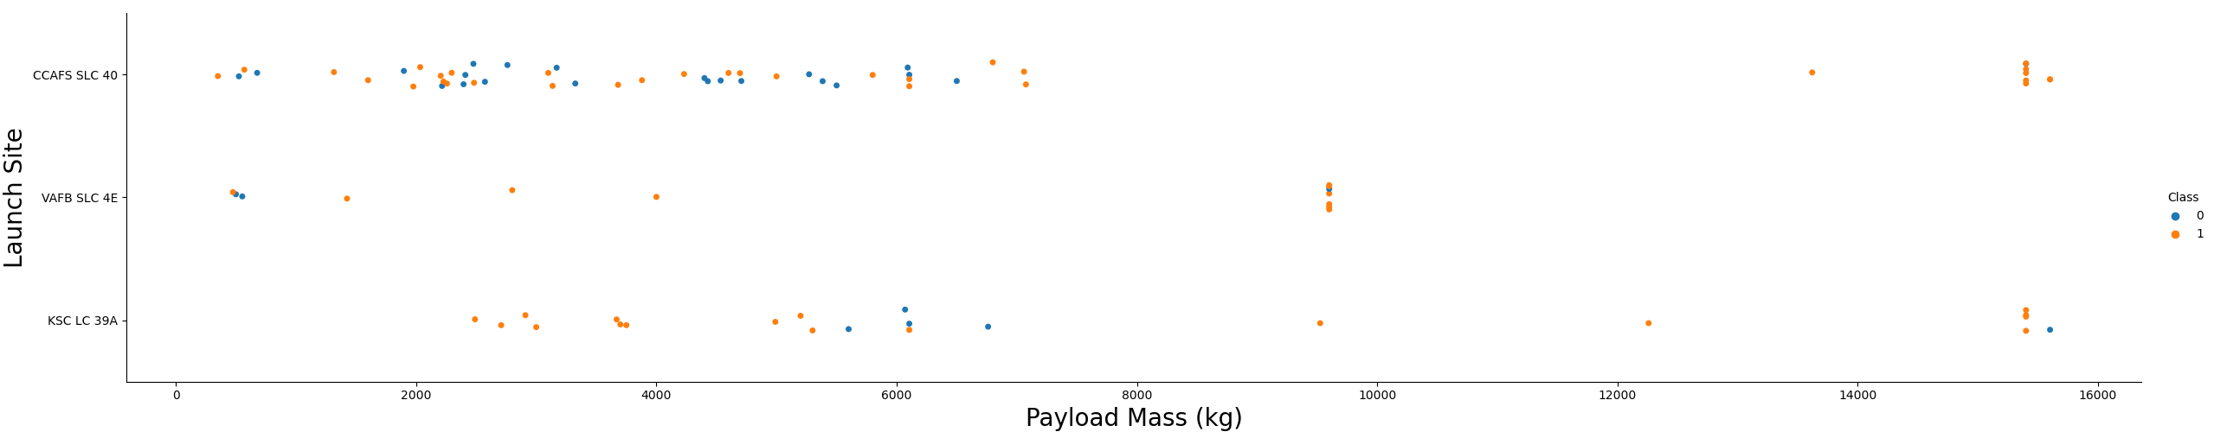
Payload vs. Launch Site
VAFB-SLC Launch Site:
No rockets have been launched for heavy payload masses exceeding 10,000 kg.
KSC LC Launch Site:
No rockets have been launched for lower payload masses less than 2,500 kg.
CCAFS SLC Launch Site:
Rockets have been launched for payload masses less than 7,500 kg and greater than 13,000 kg.

Slide 26
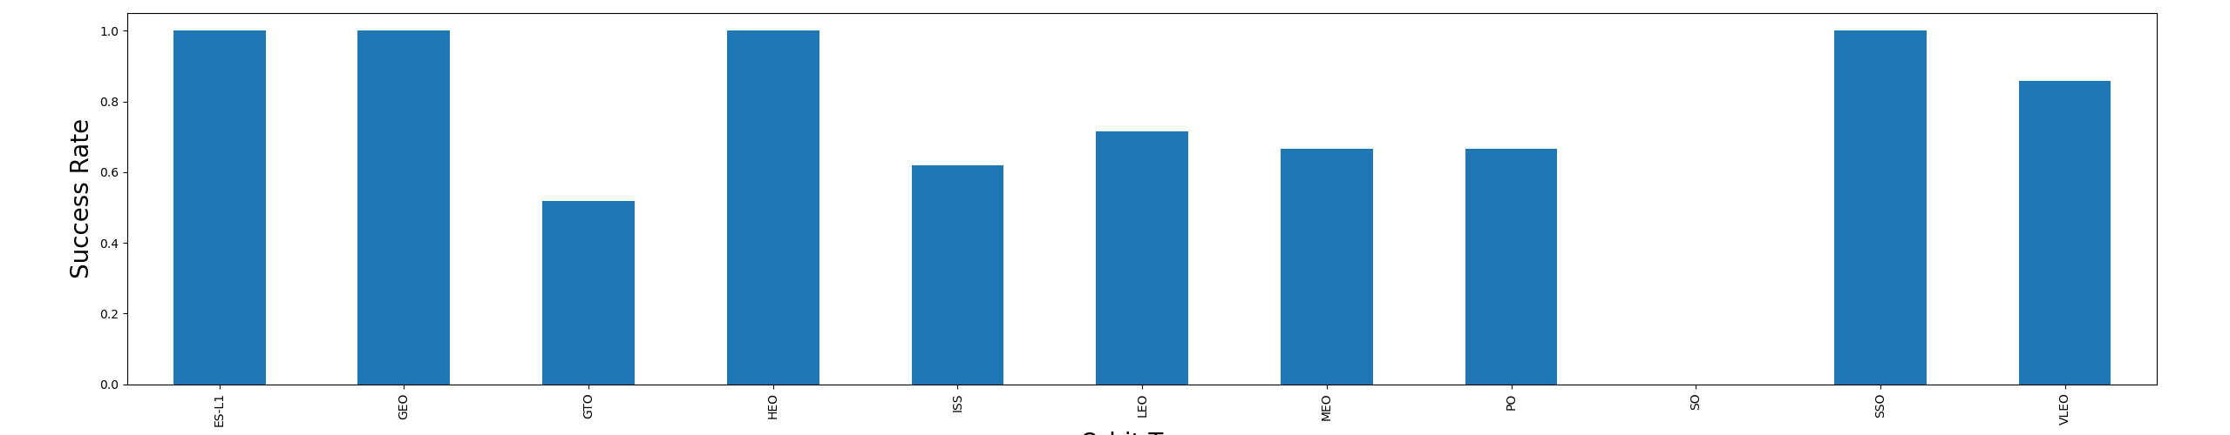
Success Rate vs. Orbit Type
Best Successful Rate:
The SSO – HEO – GEO – ESL-L1 orbit types demonstrate the highest successful rates.
Number of Launch Attempts:
The bar chart depicting successful rates should be interpreted alongside the corresponding number of launches for each orbit type.

Slide 27
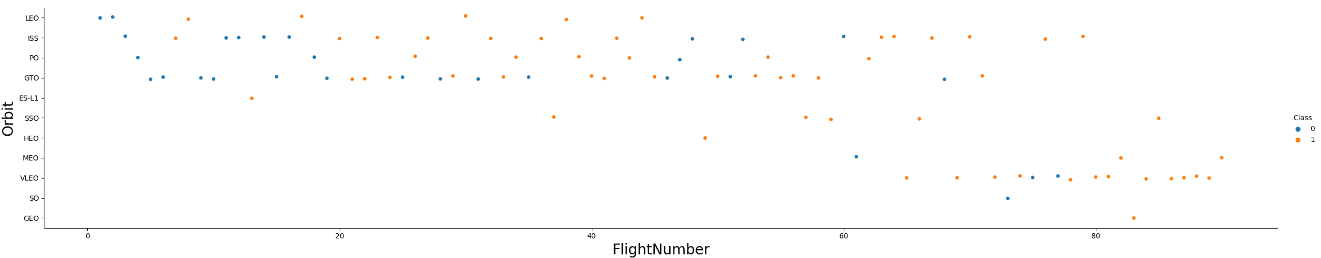
Flight Number vs. Orbit Type
Initial Failures:
Initially, there is a higher occurrence of failures in the series of launches.
However, after the first 40 launches, the ratio of unsuccessful landings reduces by 50 percent.
GO and ISS Orbits:
GO and ISS orbits have a higher concentration of launches.
These orbits exhibit the lowest ratio of successful landings.
Higher Successful Rate:
Orbits with a higher successful rate typically have a limited number of launches.
This indicates that the success rate may be influenced by the smaller sample size.

Slide 28
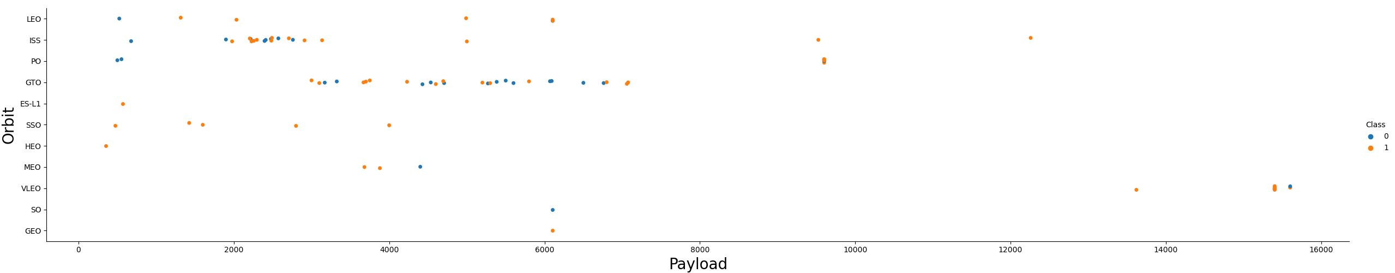
Payload vs. Orbit Type
Payload Limit:
There is a visible limit of around 7600 kg for payloads.
Less than 10 launches exceed this limit.
Successful Landing Rates:
For heavy payloads, the successful landing rate is higher for Polar, LEO, and ISS orbits.
GTO Orbit:
In the case of the GTO orbit, it is challenging to distinguish the landing rates clearly.
Both positive (successful) and negative (unsuccessful) landing rates are observed.

Slide 29
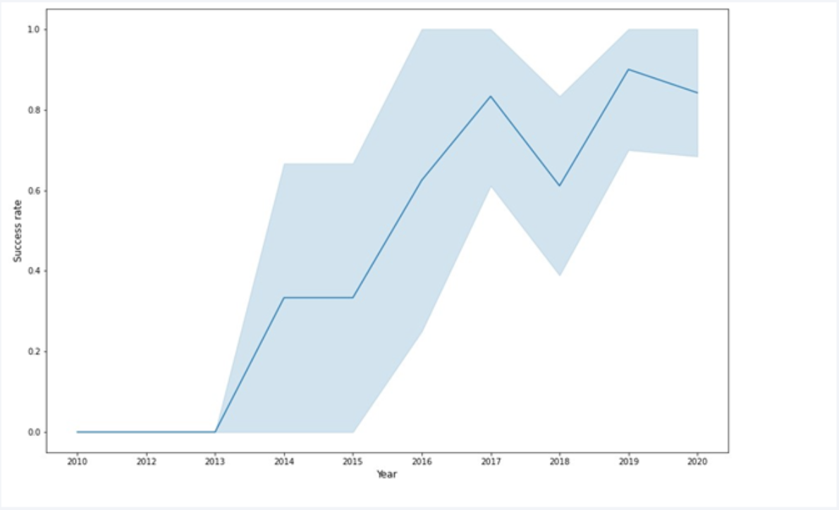
Launch Success Yearly Trend
The sucess rate since 2013 kept increasing till 2020

Slide 30
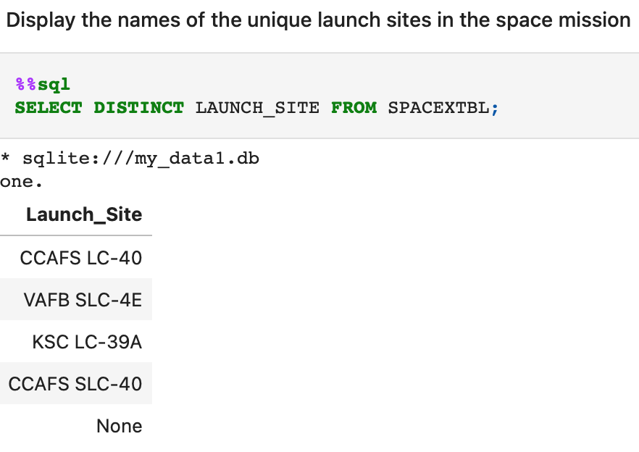
All Launch Site Names
Four Unique Launch Sites:
The space mission consists of four distinct launch sites.
Use of "DISTINCT" Statement:
The "DISTINCT" statement was utilized to identify the unique values in the launch site column.

Slide 31
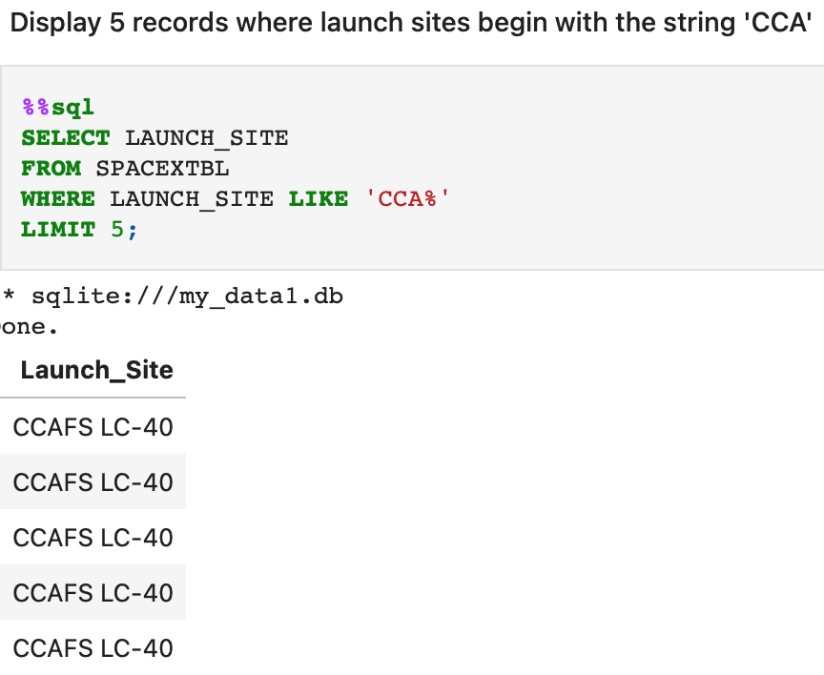
Launch Site Names Begin with 'CCA'
The query utilizes the WHERE, LIKE, and LIMIT clauses to retrieve five records where the launch sites begin with the string 'CCA'.

Slide 32
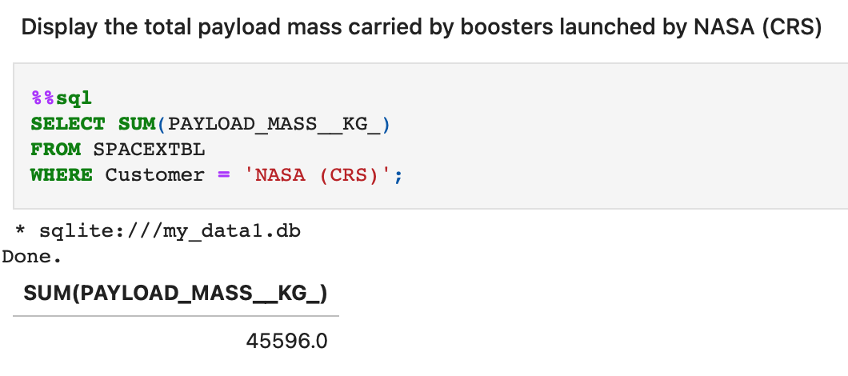
Total Payload Mass
The total payload mass carried by boosters launched by NASA (CRS) using SUM function and WHERE clause.

Slide 33
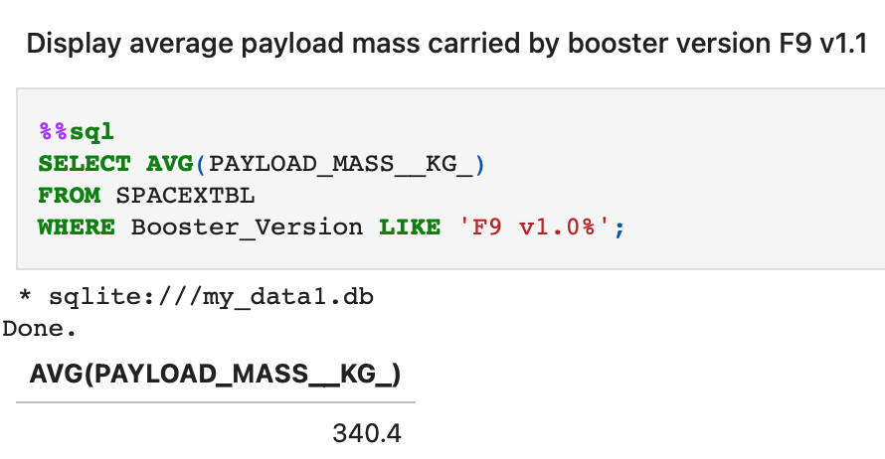
Average Payload Mass by F9 v1.1
The average payload mass carried by booster version F9 v1.1 using AVG() function and WHERE, LIKE clauses.

Slide 34
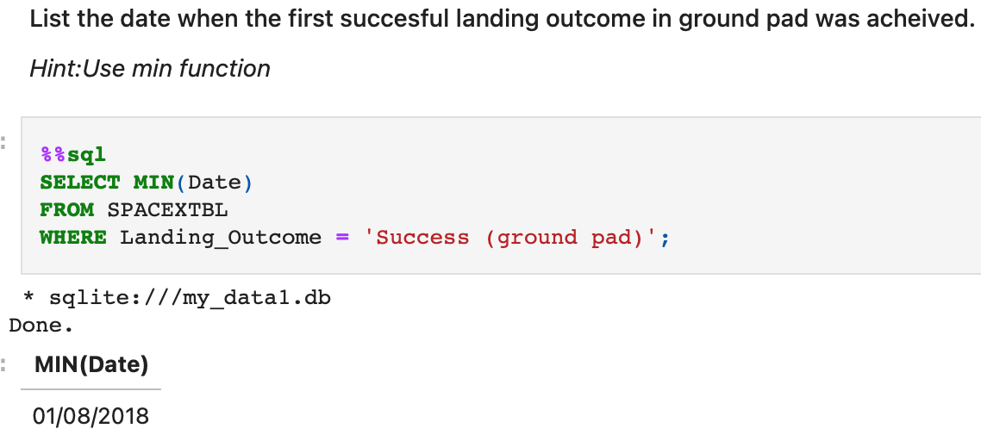
First Successful Ground Landing Date
The MIN function was used to determine the date when the first successful landing outcome in a ground pad was achieved.

Slide 35
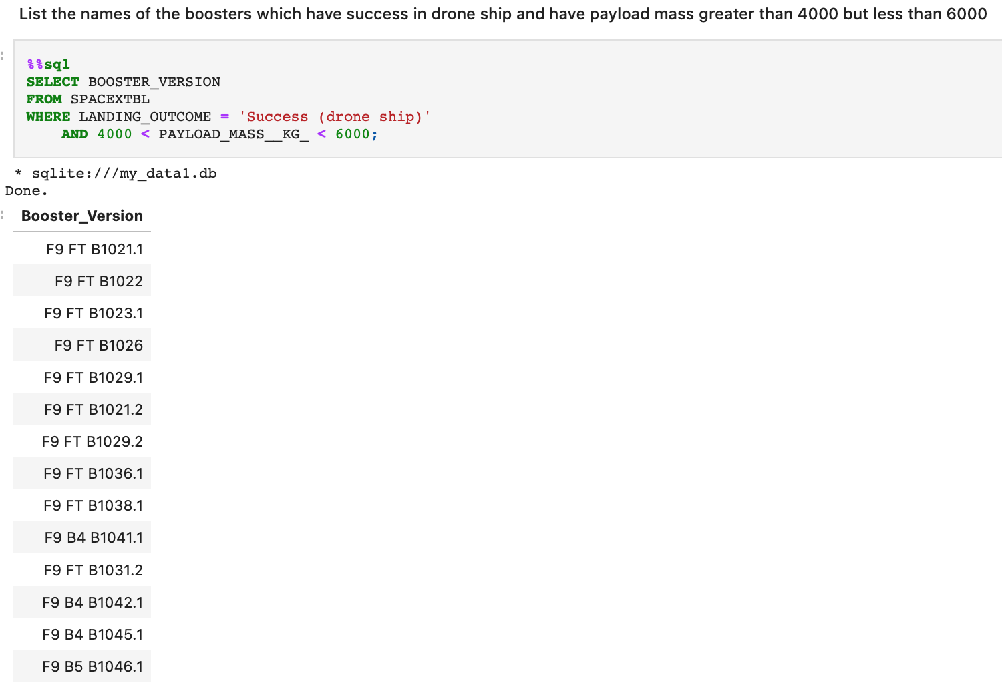
Successful Drone Ship Landing with Payload between 4000 and 6000
The WHERE clause, combined with the AND operator, was used to retrieve the names of boosters that achieved success in drone ship landings and had a payload mass greater than 4000 but less than 6000.

Slide 36
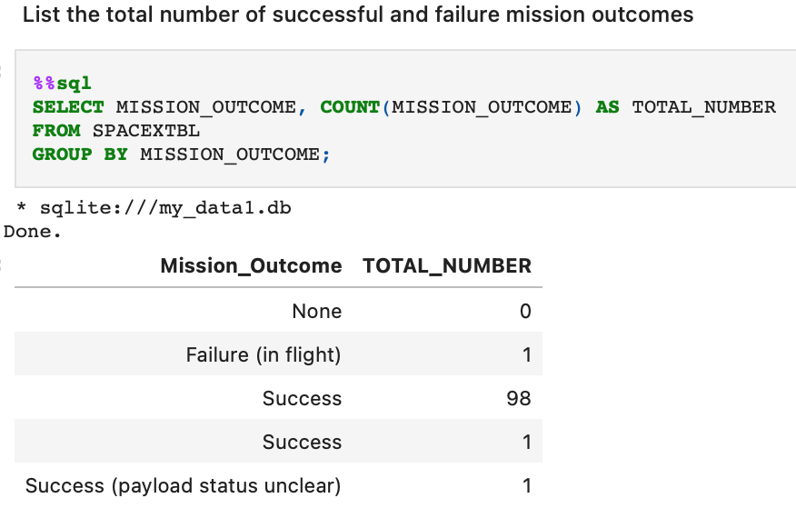
Total Number of Successful and Failure Mission Outcomes
The total number of successful and failure mission outcomes. The query uses a combination of COUNT function with GROUP BY statement.

Slide 37
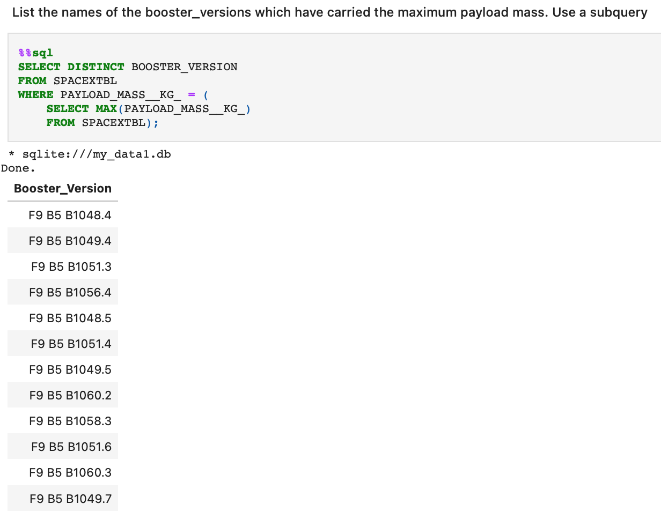
Boosters Carried Maximum Payload
A subquery was used to retrieve the names of booster versions that have carried the maximum payload mass.

Slide 38
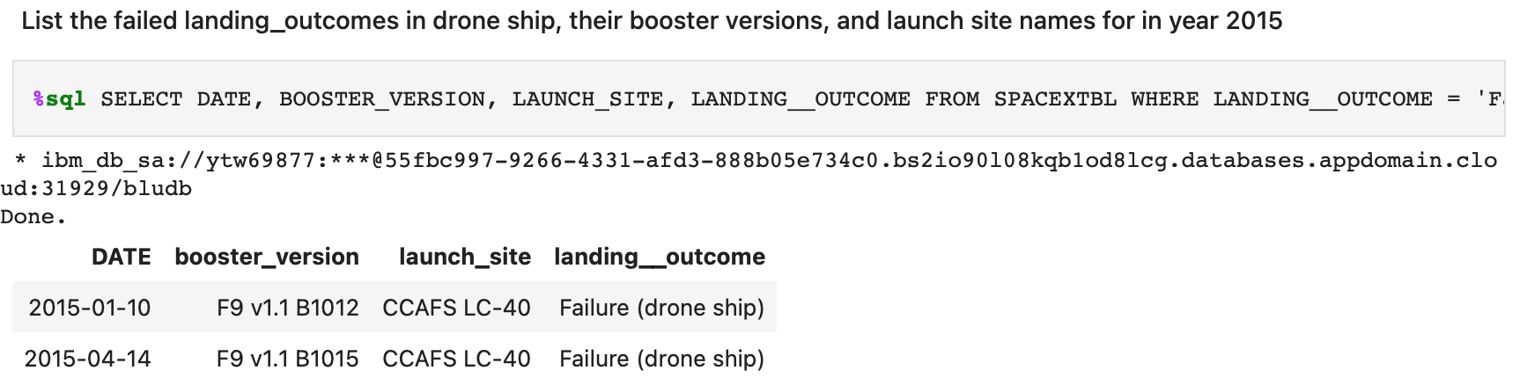
2015 Launch Records
The SQL query retrieves the date, landing outcome, booster version, and launch site names for failed drone ship landings in the year 2015.

Slide 39
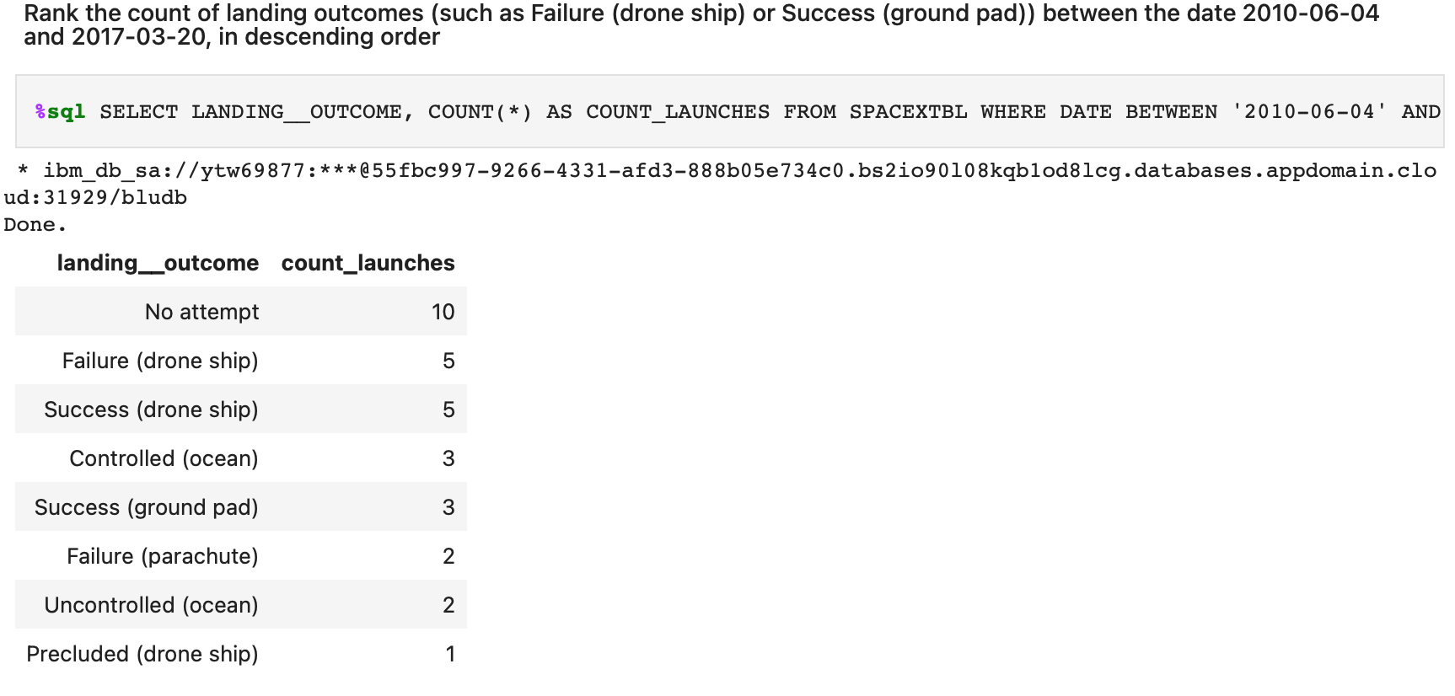
Rank Landing Outcomes Between 2010-06-04 and 2017-03-20
The count of landing outcomes (such as Failure (drone ship) or Success (ground pad)) between the date 2010-06-04 and 2017-03-20, in descending order. The query uses COUNT, WHERE, BETWEEN and GROUP BY.

Slide 40

Section 3

Slide 41
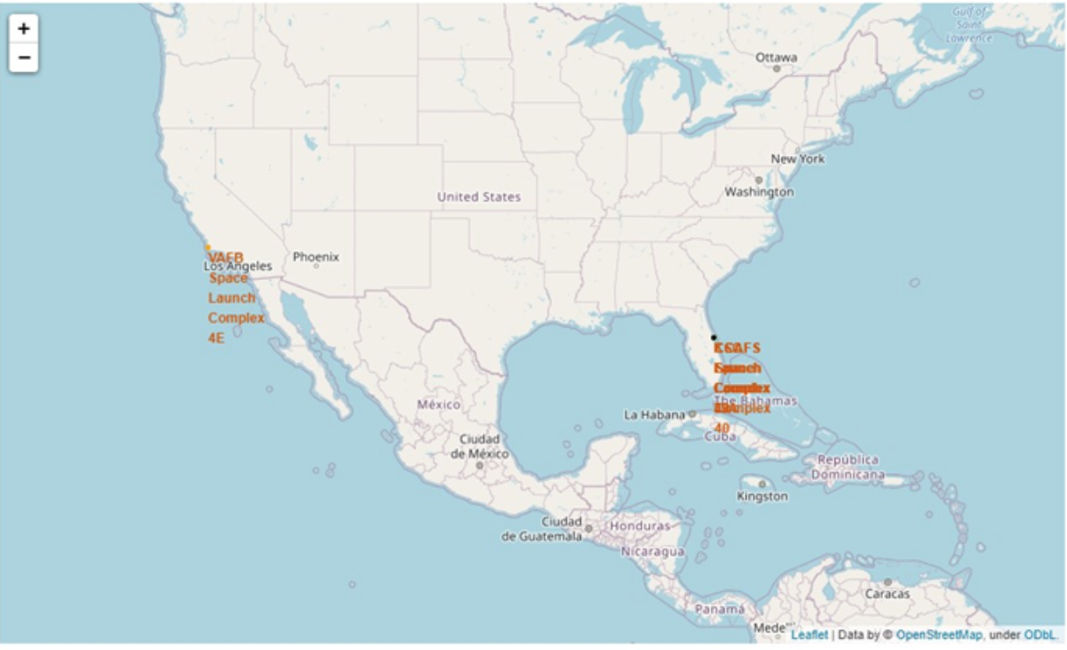
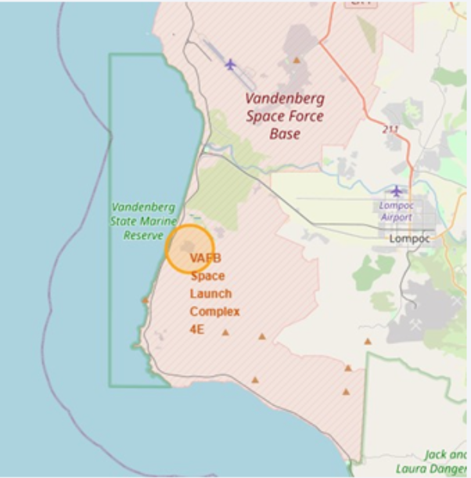
All Launch Sites
All launch sites are in very close proximity to the coast and into restricted areas.

Slide 42
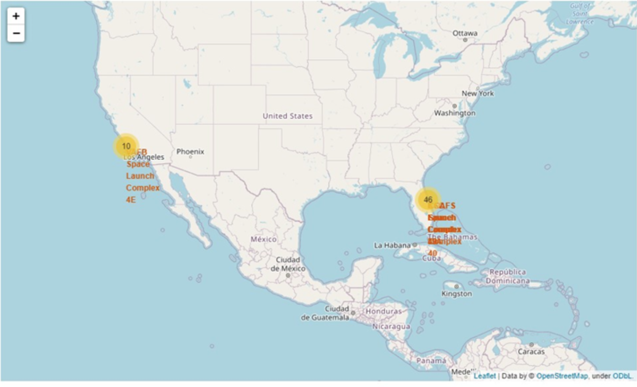
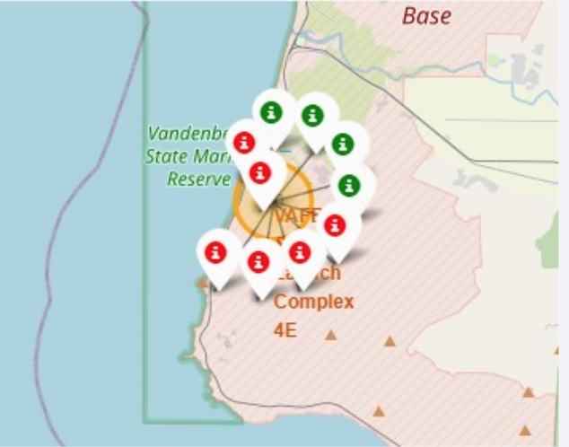
Success vs Failed Lunches for each site
The map on the left shows clusters for every launch site, and the one on the right shows a green marker if a launch was successful, and a red marker if a launch failed.

Slide 43
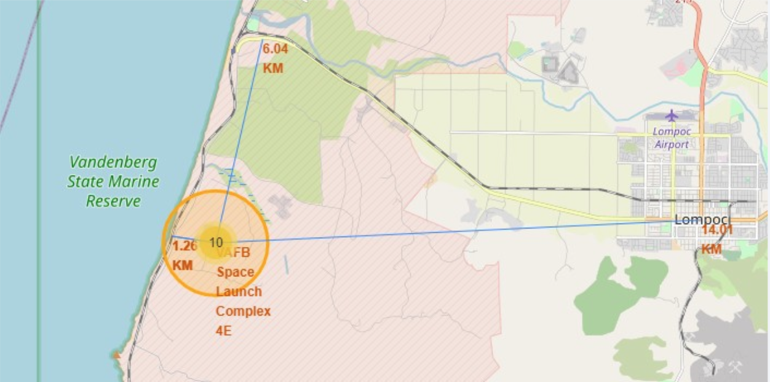
Strategic Launch Site Location: Proximity Considerations
Launch sites are strategically located in proximity to railways, roads, highways, and coastlines.
This positioning serves multiple purposes, including ease of supply and access.
Maintaining a safe distance from nearby cities is a crucial factor in site selection.

Slide 44

Section 4

Slide 45
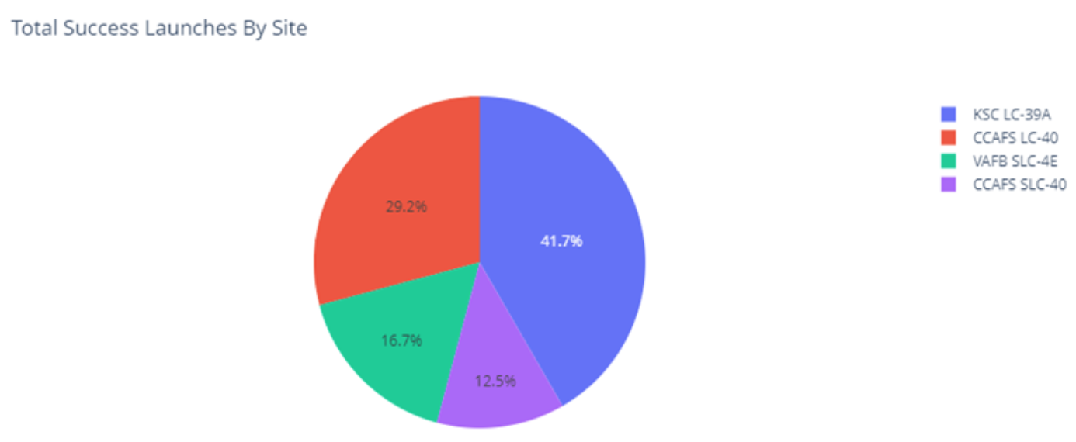
Success Launches by Launch Site: Total Count
KSC LC-39A has the highest number of successful launches, making it the top-performing site.
CCAFS LC-40 follows behind with a significant number of successful launches.

Slide 46
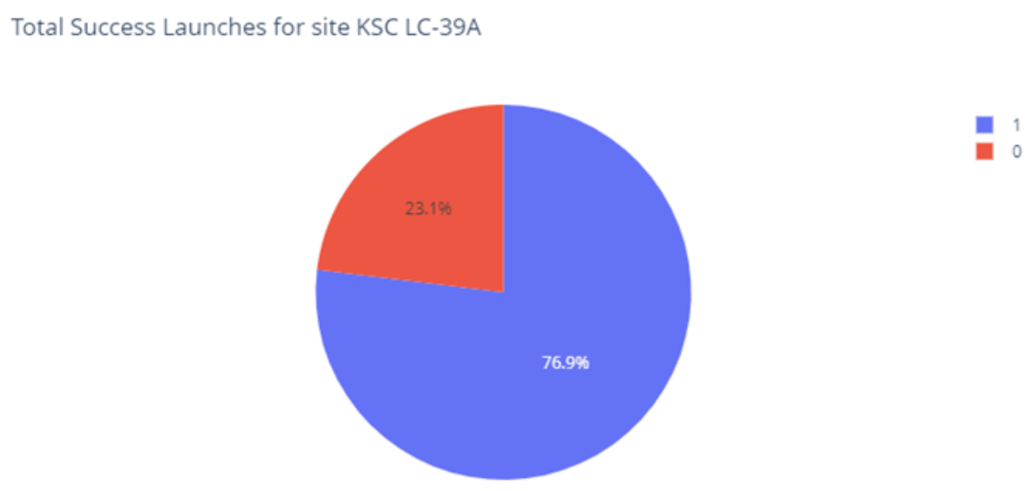
KSC LC-39A
The pie chart for the launch site KSC LC-39A showcases the highest launch success ratio among all sites.

Slide 47
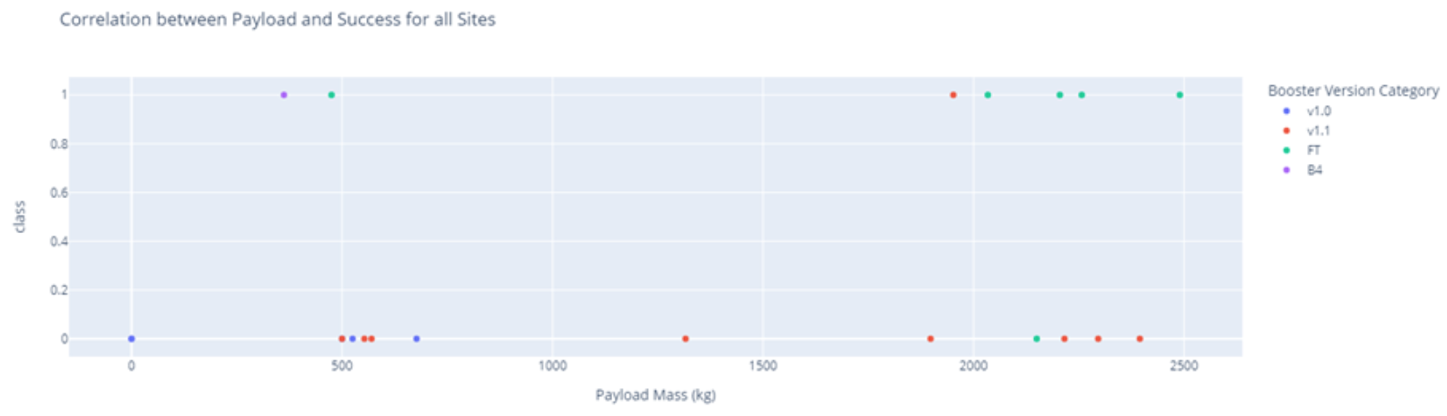
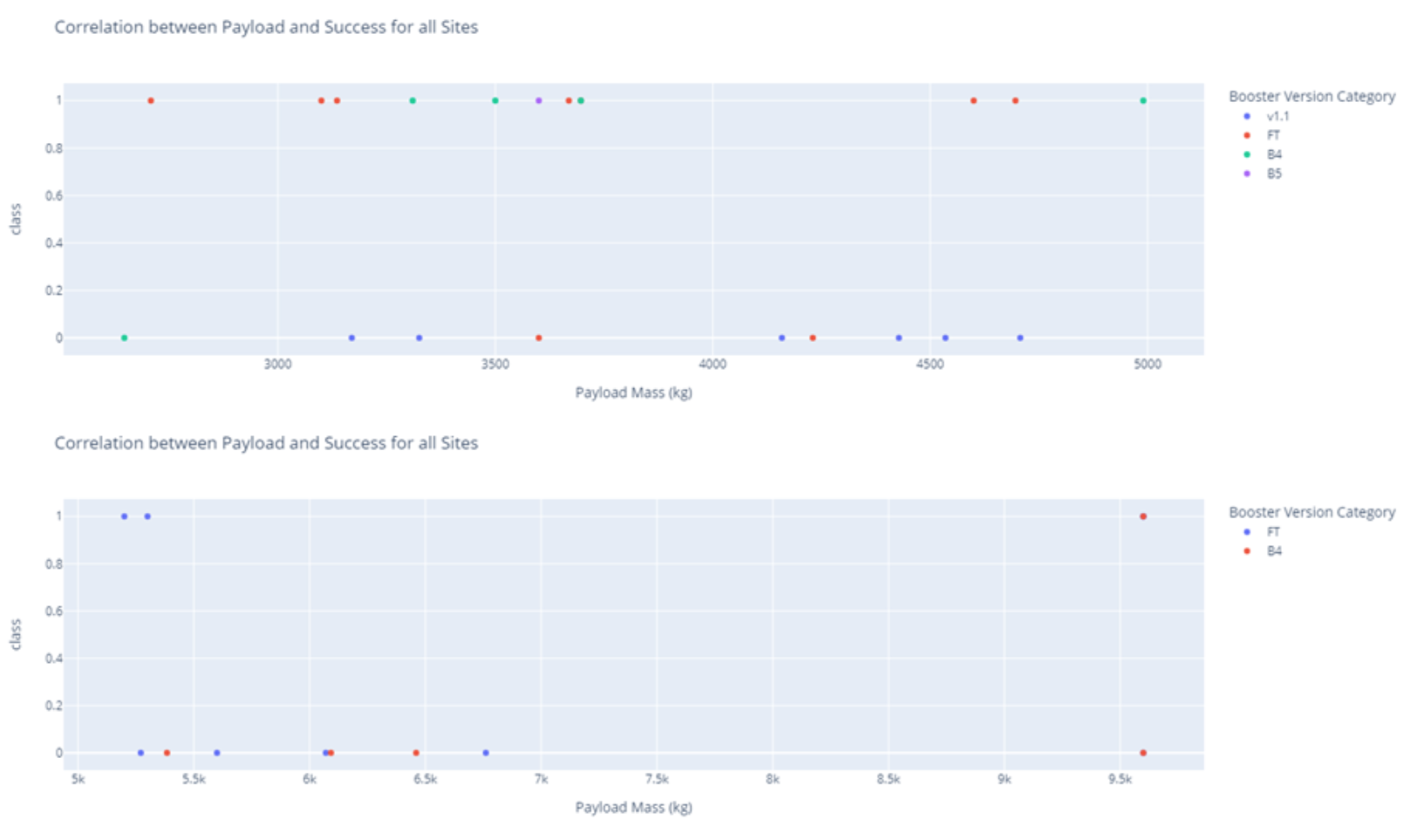
Payload vs. Launch Outcome

Slide 48
Payload vs. Launch Outcome
The scatter plot includes payload ranges of 2500 kg, 5000 kg, and 10000 kg for all launch sites.
The 2500-5000 kg payload range demonstrates a higher concentration of successful launches.
The 0-2500 kg payload range shows a higher number of failed launches.
Overall, the three payload ranges exhibit similar patterns.

Slide 49

Section 5

Slide 50
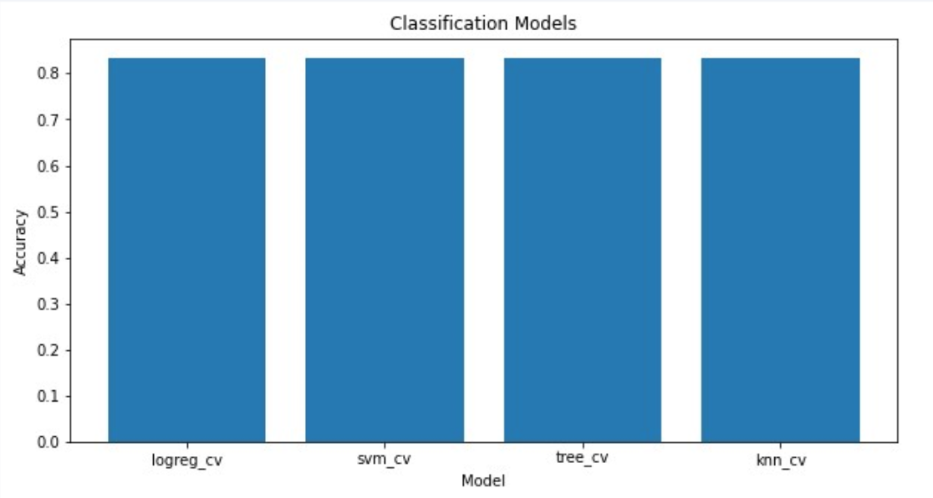
Classification Accuracy
The accuracy is the same for all trained models.

Slide 51
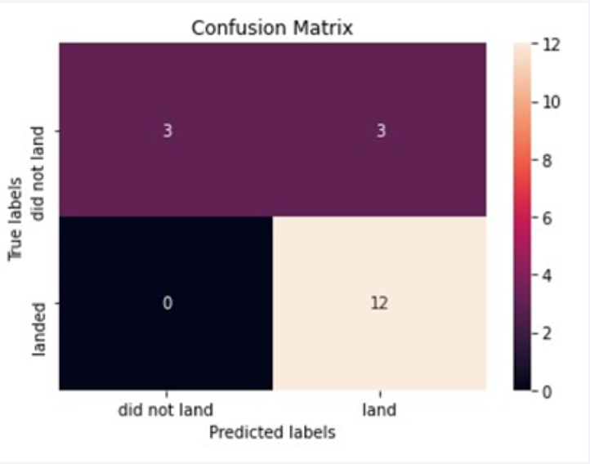
Confusion Matrix
Also the confusion matrix is the same for all models

Slide 52
Conclusions
Considering the similar accuracy across all algorithms, their performance is virtually the same.
Leveraging our machine learning model, we can predict the landing outcome of our competitor's first stage and estimate the cost of a launch.

Slide 53
Appendix
For notebooks, datasets and scripts, follow this GitHub repository link:
Applied Data Science Capstone

Slide 54


